Slide 1


Department of Computer Science and Engineering
VISUALIZING NETWORK TRAFFIC DATA FOR CYBERSECURITY ANALYSIS
Dr. S. Senthil Pandi
Associate Professor
Team ID :B21A2425C14
Manjunathan S (210701147)
Mohammed Sajjad (210701162)

Slide 2
Problem Statement and Motivation
The absence of effective visualization tools for large volumes of network traffic data, real-time analysis, and intuitive presentation hampers the prompt detection and response to cybersecurity threats. This inadequacy compromises network security and data integrity, highlighting the critical need for advanced, real-time, and user-friendly visualization solutions for cybersecurity professionals.
Increasing Complexity of Cyber Threats
Growing Volume of Network Traffic
Limitations of Traditional Monitoring Tools
Benefits of Visualization
Innovation and Research

Slide 3
Objectives
Develop Advanced Visualization Tools
Implement Real-Time Data Processing
Enhance Anomaly Detection
Improve Usability for Cybersecurity Professionals
Support Scalability and Performance
Enhance Communication and Reporting

Slide 4
Abstract
Traditional network monitoring tools, which rely heavily on manual log reviews and basic visualizations, are inadequate for handling the massive volume and complexity of modern network traffic. These tools often fail to provide real-time, actionable insights, resulting in delayed detection and response to security threats. This project aims to address these limitations by developing advanced visualization tools specifically designed for effective network traffic analysis in cybersecurity.
The primary objective of this project is to create robust, intuitive, and scalable visualization solutions that can process and display large volumes of network traffic data in real-time. The project will focus on optimizing performance to handle high data throughput and ensure seamless integration with existing Security Information and Event Management (SIEM) systems.

Slide 5
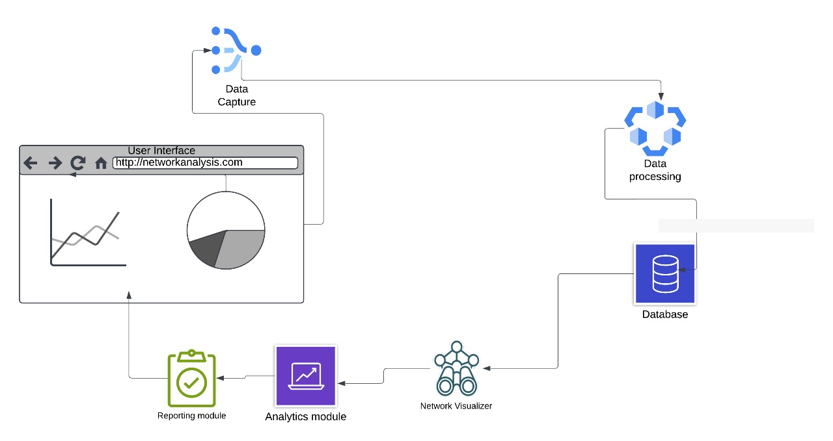
System Architecture

Slide 6
List of Modules
SYSTEM INITIALIZATION AND DATA LOADING
DATA PREPROCESSING
REAL-TIME DATA PROCESSING AND ANOMALY DETECTION
VISUALIZATION AND USER INTERACTION
SYSTEM INTEGRATION AND ENHANCEMENTS
ERROR HANDLING AND LOGGING

Slide 7
Functional Description for each modules with DFD and Activity Diagram

Slide 8
Implementation & Results of First Module
Preprocessing, which comes next after the data has been successfully loaded, is essential for getting the data ready for anomaly identification and real-time analysis.
To enable effective lookups, the preprocessing also entails indexing important properties like IP addresses and timestamps

Slide 9
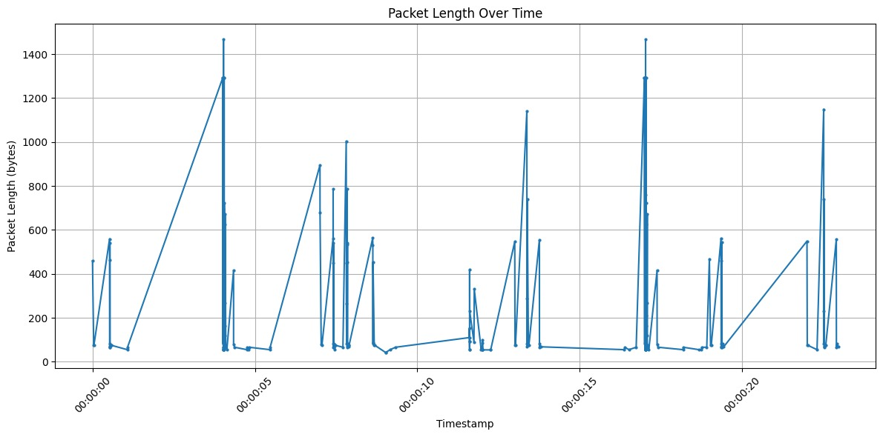
Implementation & Results of First Module
Network Simulation Insights:
Analyzed traffic patterns using Wireshark; extracted key parameters (source/destination IPs, protocols, packet lengths).
Traffic Flow Visualization:
Identified high activity periods and top data-sending IPs; highlighted anomalies (e.g., sudden spikes in packet sizes).

Slide 10
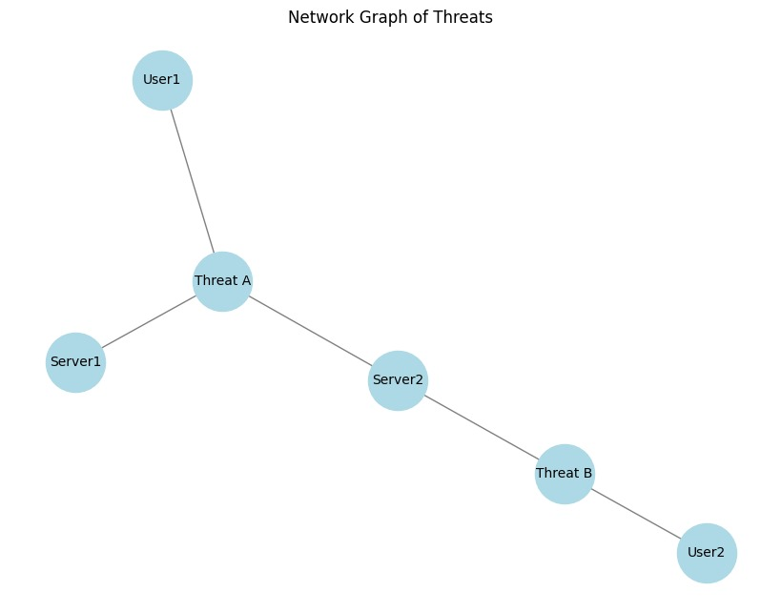
Implementation & Results of First Module

Slide 11
Conclusion & Work for Phase II
Describes the creation of a scalable, high-performance network traffic visualization platform.
Cybersecurity experts may investigate network traffic, enhance situational awareness, and expedite response times to possible security breaches with the use of the system's interactive visualizations
Works for Phase II:
Real-Time Threat Intelligence Integration.
Enhanced Visualization Features
Integration of Advanced Machine Learning Models

Slide 12
References
[1] Zineb Maasaoui,Anfal Hathah, Hasnae Bilil, Van Sy Mai, Abdella Battou, Ahmed lbath. Network Security Traffic Analysis Platform - Design and Validation.2022 IEEE/ACS 19th International Conference on Computer Systems and Applications (AICCSA).
[2] Daniele Ucci, Filippo Sobrero, Federica Bisio
Near-real-time Anomaly Detection in Encrypted Traffic using Machine Learning Technique. 2021 IEEE Symposium Series on Computational Intelligence (SSCI)
[3] Kang-Di Lu , Guo-Qiang Zeng , Xizhao Luo , Jian Weng , Weiqi Luo , and Yongdong Wu, Evolutionary Deep Belief Network for Cyber-Attack Detection in Industrial Automation and Control System, 2021. IEEE Transactions on Industrial Informatics ( Volume: 17, Issue: 11, November 2021)
[4] Kumar, P., Kumar, S.V. (2023). DDoS Attack Prediction System Using Machine Learning Algorithms. In: Tuba, M., Akashe, S., Joshi, A. (eds) ICT Systems and Sustainability. ICT4SD 2023. Lecture Notes in Networks and Systems, vol 765. Springer, Singapore.

Slide 13
References
Sanchi Agarwal, Ayon Somaddar, Paritosh Harit, Divya Thakur, Network Traffic Analysis and Anomaly Detection. 2023 3rd International Conference on Smart Generation Computing, Communication and Networking (SMART GENCON).
[6] Mansi Patel S, Raja Prabhu, Animesh Kumar Agrawal, Network Traffic Analysis for Real-Time Detection of Cyber Attacks,. 2021 8th International Conference on Computing for Sustainable Global Development (INDIACom)
[7] Swara S ,Gingade Nagashree ,B Rishika Mohan, V Mohana, Real Time Network Traffic Analysis and Visualization using Wireshark and Google Maps. 2023 3rd International Conference on Innovative Mechanisms for Industry Applications (ICIMIA 2023)
[8] Santhosh Chowhan Abhilash Kumar Saxena, Advanced Techniques in Network Traffic Analysis: Utilizing Wireshark for In-Depth Live Data Packet Inspection and Information Capture. 2023 International Conference on Communication, Security and Artificial Intelligence (ICCSAI).

Slide 14
References
[9] Rory Coulter , Qing-Long Han, Lei Pan , Jun Zhang , Yang Xiang, Data-Driven Cyber Security in Perspective—Intelligent Traffic Analysis. IEEE Transactions on Cybernetics ( Volume: 50, Issue: 7, July 2020).
[10] Pitamber Chaudhary, Vaibhav Kashyap, Naresh Sonwal, Prasanjeet Panwar, Manoj Dadheech, Mrs.Monika Bhatt, Mr.Mayank Jain, Network Traffic Analysis using Wireshark(2023)
[11] Oleksandr Laptiev, Andrii Musienko, Volodymyr Nakonechnyi, Andrii Sobchuk, Sergii Gakhov, Serhii Kopytko, Algorithm for Recognition of Network Traffic Anomalies Based on Artificial Intelligence. 2023 5th International Congress on Human-Computer Interaction, Optimization and Robotic Applications (HORA)
[12] Soo-Yeon Ji, Bong-Keun Jeong, Dong Hyun Jeong, Evaluating visualization approaches to detect abnormal activities in network traffic data. International Journal of Information Security, Volume 20, Issue 3(2021).

Slide 15
Paper Publication Status
TITLE: Visualizing network traffic data for cybersecurity analysis
AUTHORS: Dr. P. Kumar, Dr. Senthil Pandi S, Manjunathan S, Mohammed Sajjad Azam
PUBLICATION STATUS: Submitted

Slide 16
Thank You

